Slide 1
Tracking of Flow of Code from Stackoverflow to Github
Rutwik Kulkarni
Kulendra Kumar Kaushal
CS 5704: Software Engineering, Spring 2020 Instructor: Dr. Na Meng Department of Computer Science, Virginia Tech Blacksburg, VA 24061

Slide 2
Problem Statement
We plan to conduct an empirical study to investigate the presence of Stack Overflow snippets in the source code of popular public Github repositories.
StackOverflow
Github
To

Slide 3
Research Questions
This Study will help to address the following Research Questions
RQ1: To find the most referenced answer to any Stack Overflow question and recommend it to the developer
RQ2: To analyze whether the most favourite answer is the most referenced answer
RQ3: To analyze the extent to which the code is copied from Stack Overflow to Github
RQ4: Cross language analysis of the above research questions.

Slide 4
Proposed Solution
Obtain the data from Stack Overflow
Obtain the data from Github
Merge and Pre-Process data
Quantitative Analysis of Stack Overflow to Github
Exploratory Visual analysis

Slide 5
STEP 1: Dataset Creation
Multiple open data corpus of StackOverflow dump and Github extracts are available.
We decided to choose Google BigQuery public datasets over Stack Exchange Data Explorer[SEDE]
SEDE can only output up to 50,000 rows
SEDE protects itself from abuse with CAPTCHAs, and has no API.
Plenty of other datasets shared on BigQuery including Github extracts.
BigQuery allows us to add our own dataset and take multiple joins.
Used Google BigQuery to extract most upvoted answer for each stack overflow question.
Obtained all Github file referencing the above StackOverflow posts.

Slide 6
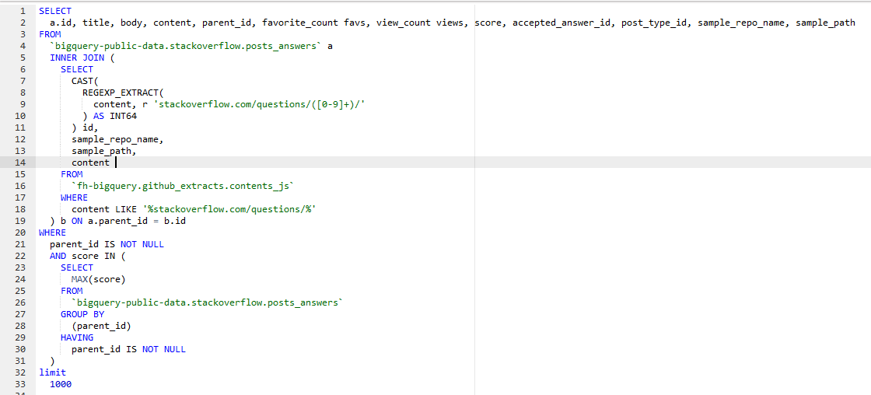
Query used for analysis
To extract the most favourite answer from stackoverflow and the reference of its corresponding question on github we used the following query:

Slide 7
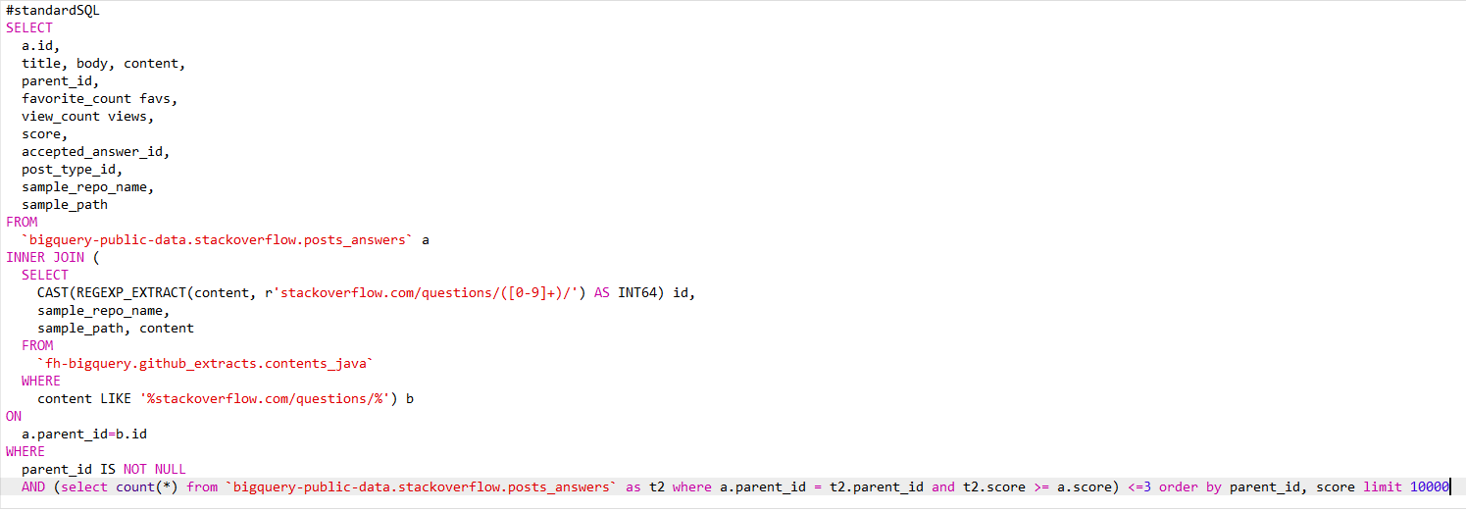
Query for Extracting multiple answers

Slide 8
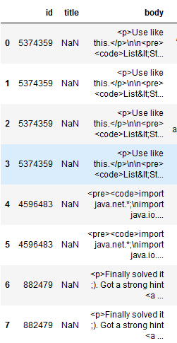
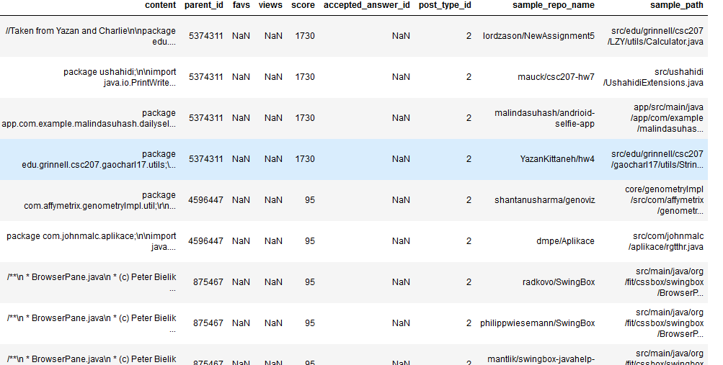
Sample Dataset Obtained from the Query.

Slide 9
STEP 2: Data Preprocessing
StackOverflow post contents are present in XML format and code snippet is present between code-tag. e.g.
Github code is present in normal text format.
Unknown characters removal from the data.
Each code snippet from stack overflow answer and github code repo stored in a separate file for further analysis.
'<p>Use like this.</p>\n\n<pre><code>List&lt;String&gt; stockList = new ArrayList&lt;String&gt;();\nstockList.add("stock1");\nstockList.add("stock2");\n\nString[] stockArr = new String[stockList.size()];\nstockArr = stockList.toArray(stockArr);\n\nfor(String s : stockArr)\n System.out.println(s);\n</code></pre>'

Slide 10
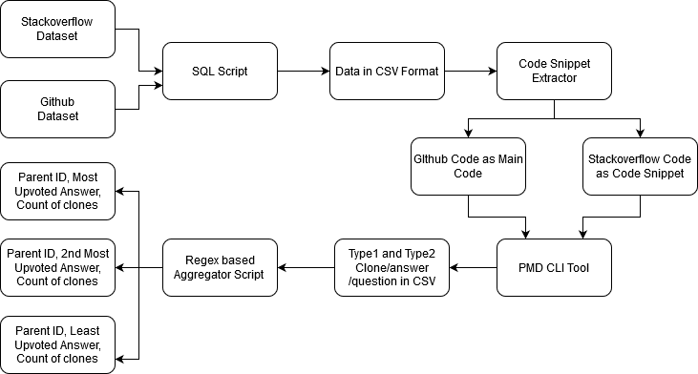
Implemented Architecture

Slide 11
STEP 3: Clone Detection
Used PMD 5.4.1 duplicate code detector to identify the presence of type 1 and type 2 clones.
PMD does file to file matching for clone detection.
PMD detects clone based on the number of similar tokens.
Clone is defined based on optimal threshold value for number of similar tokens.
Used PMD to detect SO to Github and Github to Github clone detection.
Manual validation of the results obtained.

Slide 12
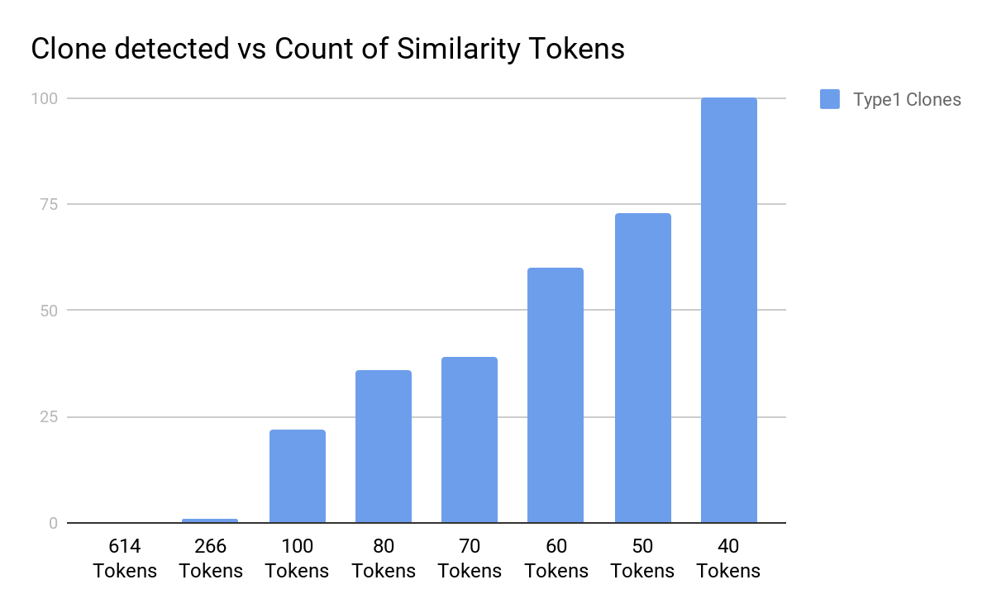
RESULTS: Java Type 1 Clone
Total 1000 Github files referencing StackOverflow questions analyzed.
334 Unique questions were referred.
Clones found for different number of matching tokens.
Our initial choice of tokens for estimating closes was 10 based on manual observation.

Slide 13
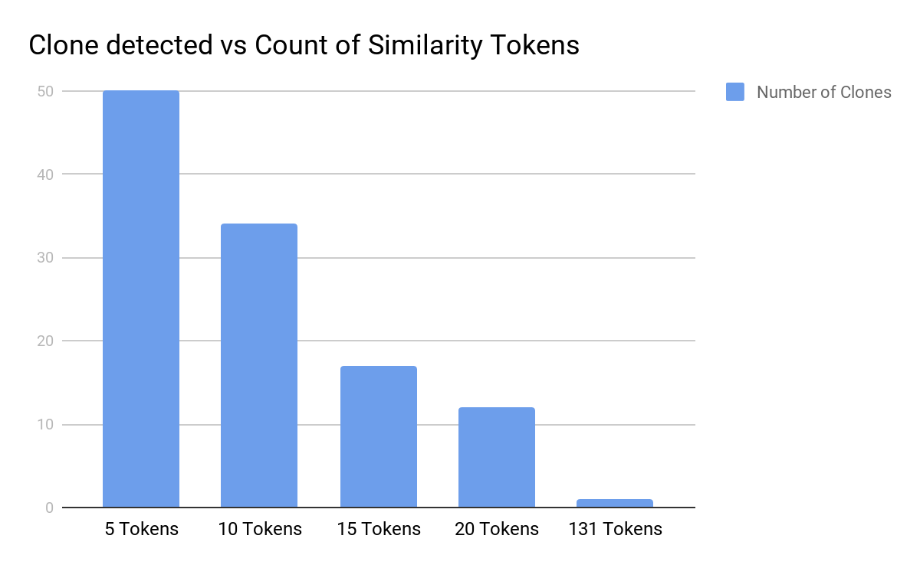
RESULTS: Javascript Type 1 Clone
Total 1000 Github files referencing StackOverflow questions analyzed.
212 Unique questions were referred.
Total Clones(not grouped by questions) found for different number of matching tokens.
Our initial choice of tokens for estimating closes was 10 based on manual observation.

Slide 14
Rosetta Baseline Tokens For Different Tasks
Program | Java | Java Script | Ratio
BST | 502 | 146 | 3.43
Hello World-Text | 35 | 8 | 4.375
Hello World-Server | 154 | 70 | 2.2
Hello World Graphical | 417 | 8 | 52.125
Swap | 74 | 39 | 1.8974
While Loop | 47 | 34 | 1.382
For loop | 77 | 89 | 0.8651
MatMul | 277 | 338 | 0.819
Null obj | 26 | 44 | 0.59
Median of ratios of Java to Javascript = 1.89

Slide 15
Rosetta Baseline Tokens For Different Tasks
From the previous manual analysis, we found that the copied program with more than 10 tokens in javascript made sense
Additionally as the smallest program that can be copied is Hello World and it contains 8 tokens in JavaScript
Therefore on the basis of based on previous manual observation and Hello world analysis 2 programs are considered to be clones when number of tokens are equal to 10 (Approximation of 8)
For java we calculated number of tokens so that a program can be considered as clones based on median ratio i.e 10*1.89 ~ 19 tokens

Slide 16
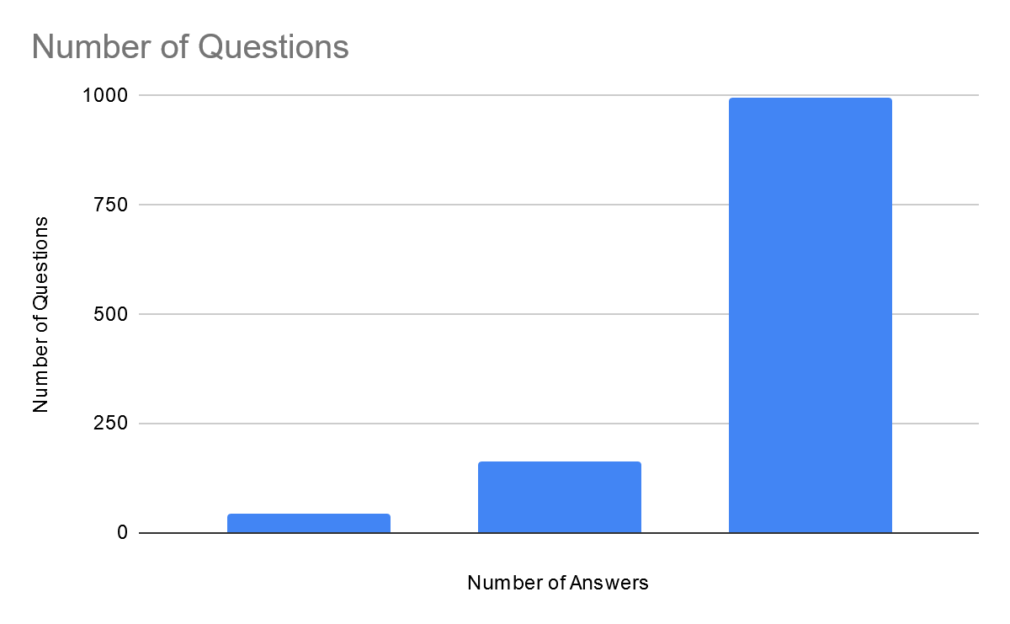
Results :Java
A new data of 10,000 questions containing multiple answers of the same question and their references was queries
Basic Analysis of the data:
Unique Questions :1200
Unique Answers: 3552
Questions with only 1 answer 43
Questions with 2 answers 162
Questions with 3 answers 995

Slide 17
Results : Type 1 Clones Java
Out of all the questions analyzed 66 Questions had their most upvoted answer referenced once or more.
56% (37/66) of times most upvoted answer has highest number of referenced github repositories while 31% (20/66) of times, 2nd most upvoted answer has higher number of referenced github repositories for the same question.
It was very interesting to know that for 13% (9/66) questions the least favourite Answer has highest number of referenced github repositories as compared to other answers of the same question.

Slide 18
Results: Type 2 Clone Java
Out of all the questions analyzed 47 Questions had some or the other answer referenced
Most favourite Answer was referenced 63.8% (30/66) number of times
For 36.17% (17/47) of questions the most referenced answer was not the most favorite one
It was very interesting to know that for 19% (9/47) questions the least favourite Answer is the most referenced.

Slide 19
Analysis: Java
Two code snippets are being concluded to be type 1 clone if number of matching tokens are 19 or more.
Two code snippets are being concluded to be type 2 clone if number of matching tokens are 30 or more.
For type 2 clones, We didn’t chose 19 because PMD requires a very high computing resource.
Out of 3300 referenced github repositories, only 66 (20 when minimum tokens was 30) SO Questions had referenced answers were type 1 while 47 question’s answers were type 2 cloned in github repositories => RQ3

Slide 20
Analysis: Java continued
Found most referenced answer to the question =>RQ1
For both type 2 and type 1 clones, most upvoted answer need not always be most referenced => RQ2

Slide 21
Results :Javascript
A new data of 1000 questions containing multiple answers of the same question and their references was queries
Basic Analysis of the data:
Unique Questions : 212
Unique Answers: 227

Slide 22
Analysis: Javascript
Two code snippets are being concluded to be type 1 clone if number of matching tokens are 10 or more.
Out of 1000 referenced github repositories, only 34(total) were type 1 clones. => (Partly RQ2)
Out of 1000 referenced github repositories, only 17 SO Questions had referenced answers were type 1 cloned in github repositories => RQ3
PMD doesn’t allow us to find type 2 clones for Javascript => (Partly RQ2)

Slide 23
Cross Language Analysis (RQ4)
Based on empirical study conducted using tasks and their codes available on Rosetta in different programming languages, 2 tokens of Javascript is equivalent to 1 token of Java.
For Java, 5.5% (66/1200) of the questions have their most upvoted answer referenced once or more while in case of Javascript, the percentage is 15%(17/112).
As data is taken from a normal distribution. Considering Rossetta equivalent token as for Java and Javascript as baseline, we can say that for Javascript most upvoted answer is referenced more as compared to Java.

Slide 24
Challenges
Normal string matching of stackoverflow answers and github extracts doesn’t give any good results
PMD does not support Type 2 clones for Javascript
Limit on download of data for Google BigQuery (Free account)
StackOverflow and Github are getting updated constantly, so there could be a lack in consistency of the data. (i.e The answer which is mentioned to be most upvoted the dataset, may have more upvotes in dataset or may not be the topmost answer)

Slide 25
Future work
Analyze the flow of code from the github repositories to stackoverflow answers
Machine learning based clone detection using TF-IDF/ text similarity metrics
Adding more languages to perform cross language analysis for completing RQ4
Build UI to recommend the most referenced answer for a given stackoverflow question.

Slide 26
Questions??

Slide 27
References
https://cmustrudel.github.io/papers/socialcom13.pdf
https://empirical-software.engineering/assets/pdf/emse18-snippets.pdf

Slide 28
